Slide 1
AIM
The objective is to pre-process the MR images of brain, and hence to extract the texture features.
Finally to develop a suitable classifier to classify the images as normal or abnormal for further treatment of brain tumor.

Slide 2
LITERATURE SURVEY
“Efficient Quality Analysis of MRI Image Using Preprocessing Techniques”, S.Rajeshwari, T.Sree Sharmila, IEEE Conference on Information and Communication Technologies,2013.
“Image Resolution Enhancement by Using Discrete and Stationary Wavelet Decomposition”, IEEE Transactions on Image Processing, vol. 20, No. 5, May 2011.

Slide 3
LITERATURE SURVEY
“Brain Cancer Detection using Neuro Fuzzy Logic”, Laxmi Ghodke, Apeksha Naik, Rahul Konale, Suchit Mehta, International Journal of Electronic Signals and Systems.
“Image Texture Feature Extraction Using GLCM Approach”, P. Mohanaiah, P. Sathyanarayana, L. GuruKumar, International Journal of Scientific and Research Publications, Volume 3, Issue 5, May 2013.
“Brain Tumour Extraction from MRI Images Using MATLAB”, Rajesh C. Patil, Dr. A. S. Bhalchandra, International Journal of Electronics, Communication & Soft Computing Science and Engineering.

Slide 4
INTRODUCTION
Magnetic Resonance Imaging (MRI)
Magnetic resonance imaging (MRI) can be used to produce detailed images of almost any part of the body.
Tumor Classification
  Automatic detection and classification of images is a challenging task in the field of medical image processing. In recent years, the occurrence of brain tumor has been on the rise. Hence in this project, a method is proposed for automatic classification of MR brain images as normal or abnormal.

Slide 5
PROBLEM IDENTIFICATION
Medical images acquired from different modalities such as CT, MRI etc. may be corrupted by noises. Also the medical images verified by the physicians manually may sometimes lead to misclassification.
SOLUTION
Thus noise reduction and automatic detection are of great importance in recent days.
By taking this into account, a new method is proposed in this project to classify MR Brain images as normal or abnormal.

Slide 6
FLOW DIAGRAM
INPUT IMAGE
PRE-PROCESSING
ENHANCED IMAGE
GLCM BASED FEATURE EXTRACTION
SVM BASED CLASSIFIER
5

Slide 7
DE-NOISING OF MRI SCANS
Noise Filtration using
  Mean
  Median
  Wiener
Performance comparison of filters by evaluating
  PSNR
  MSE

Slide 8
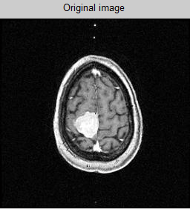
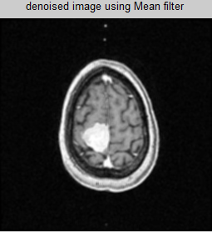
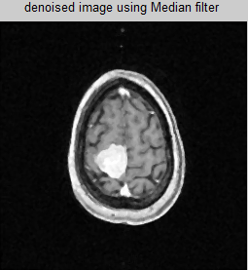
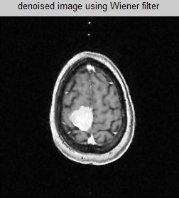
RESULTS OF FILTERING AGORITHMS

Slide 9
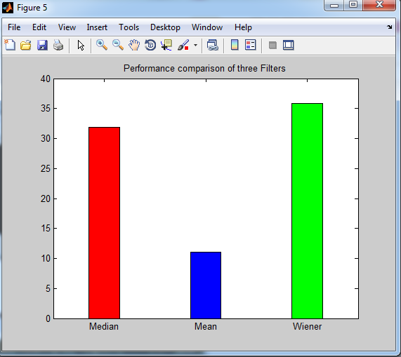
PERFORMANCE COMPARISON
S.No | Filters | PSNR (dB4
1. | Mean | 10.94
2. | Median | 24.45
3. | Wiener | 26.41

Slide 10
ENHANCEMENT TECHNIQUES
Resolution Enhancement using
  DWT
  SWT
  DWT & SWT
Performance comparison of transforms by evaluating
  PSNR
  MSE

Slide 11
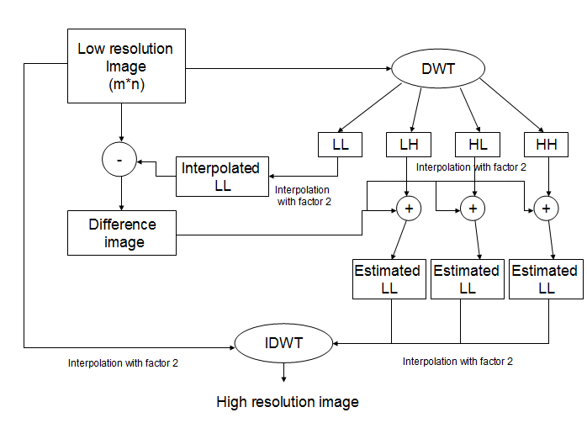
DWT block diagram

Slide 12
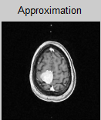
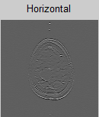
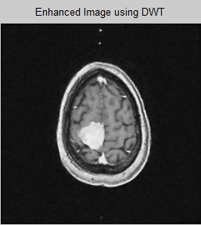
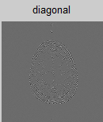
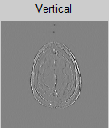
ENHANCED OUTPUT USING DWT

Slide 13
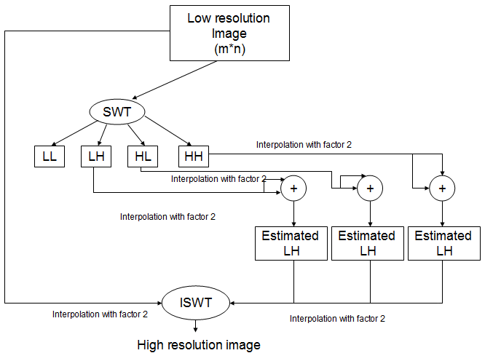
SWT block diagram

Slide 14
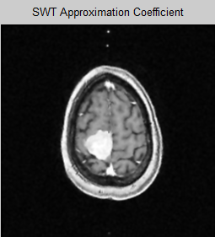
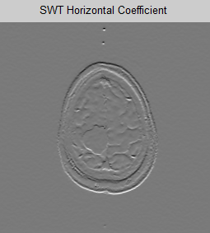
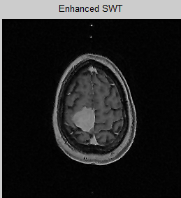
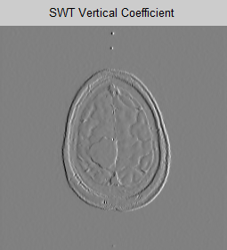
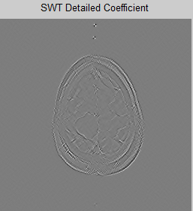
ENHANCED OUTPUT USING SWT

Slide 15
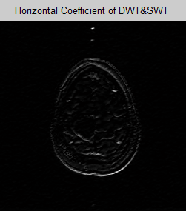
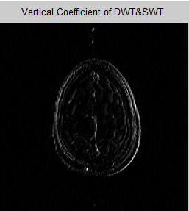
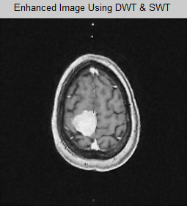
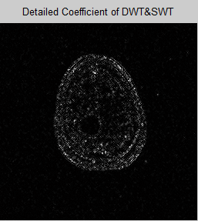
ENHANCED OUTPUT USING DWT &SWT

Slide 16
PERFORMANCE COMPARISON
S.No | Transform | Peak Signal to Noise Ratio (PSNR) dB
1 | Discrete Wavelet Transform (DWT) | 16.99
2 | Stationary Wavelet Transform (SWT) | 17.16
3 | DWT & SWT | 17.23

Slide 17
BLOCK DIAGRAM OF FEATURE EXTRACTION
Enhanced Image
Thresholding
Binary Image
Morphological Operations
Erosion & Dilation
Extraction of Region of Interest
Computation of Statistical Feature using GLCM

Slide 18
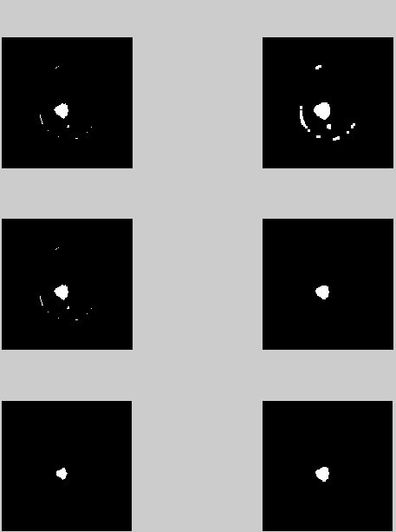
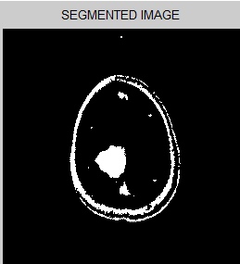
RESULTS OF SEGMENTATION AND MORPHOLOGICAL OPERATIONS
ABNORMAL IMAGE
MORPHOLOGICAL OPERATIONS
erosion
dilation

Slide 19
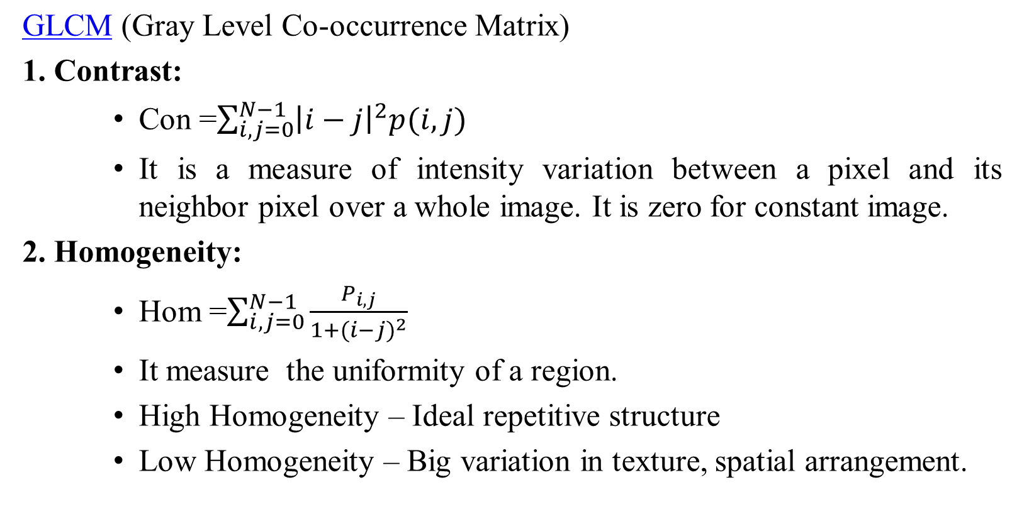
STATISTICAL FEATURES COMPUTATION

Slide 20
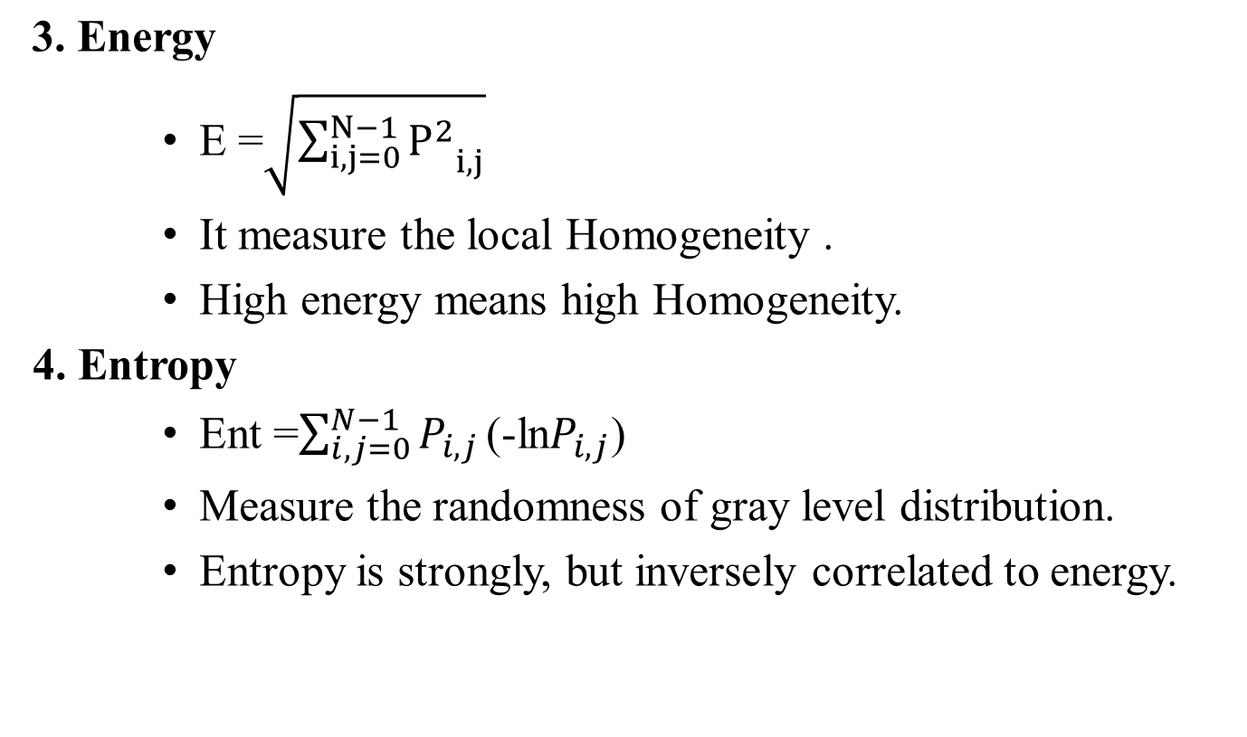
CONTINUED….

Slide 21
CONTINUED…
5.Correlation:
Measures the joint probability occurrence of the specified pixel pairs.

Slide 22
RESULT OF STATISTICAL EXTRACTION
Parameters Samples | Contrast | Correlation | Energy | Homogeneity | Entropy
Sample 1 | 0.0801 | 0.9448 | 0.7056 | 0.9758 | 0.7579
Sample 2 | 0.0821 | 0.8757 | 0.7538 | 0.9709 | 0.6962
Sample 3 | 0.0601 | 0.9346 | 0.6335 | 0.9812 | 0.7281
Sample 4 | 0.0648 | 0.9475 | 0.7244 | 0.9811 | 0.7579
Sample 5 | 0.0805 | 0.9313 | 0.6490 | 0.9729 | 0.7579
Sample 6 | 0.0604 | 0.9424 | 0.6509 | 0.9822 | 0.7281
Sample 7 | 0.0643 | 0.9485 | 0.7114 | 0.9814 | 0.7579
Sample 8 | 0.0642 | 0.9476 | 0.7401 | 0.9813 | 0.7579
Sample 9 | 0.0756 | 0.9216 | 0.6254 | 0.9733 | 0.7281
Sample 10 | 0.0833 | 0.9406 | 0.6972 | 0.9747 | 0.7579

Slide 23
BLOCK DIAGRAM OF SVM CLASSIFIER
Statistical features
Apply features as input to SVM
SVM classifies on the basis of features obtained
Normal
Abnormal

Slide 24
SUPPORT VECTOR MACHINE
SVM is a binary classifier based on supervised learning which gives better performance than other classifiers.
SVM classifies between two classes by constructing a hyper plane in high-dimensional feature space which can be used for classification.
Linear SVM classifier.
Non-Linear SVM classifier.

Slide 25
PERFORMANCE EVALUATION OF CLASSIFIER
Sensitivity and Specificity are statistical measures of the performance of a binary classification test.
Sensitivity measures the proportion of the actual positives which are correctly identified.
Specificity measures the proportion of negative which are correctly identified.

Slide 26
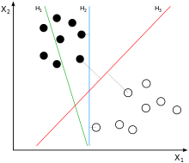
LINEAR SVM
H1 does not separate the classes.
H2 does, but only with a small margin.
H3 separates them with the maximum margin.

Slide 27

NON-LINEAR SVM
To create nonlinear classifiers by applying the kernel trick to maximum-margin hyper planes.
The resulting algorithm is formally similar, except that every dot product is replaced by a nonlinear kernel function.
This allows the algorithm to fit the maximum-margin hyper plane in a transformed feature space.

Slide 28
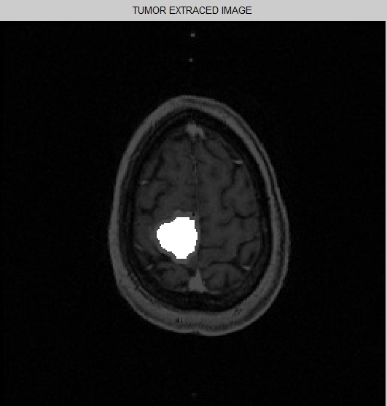
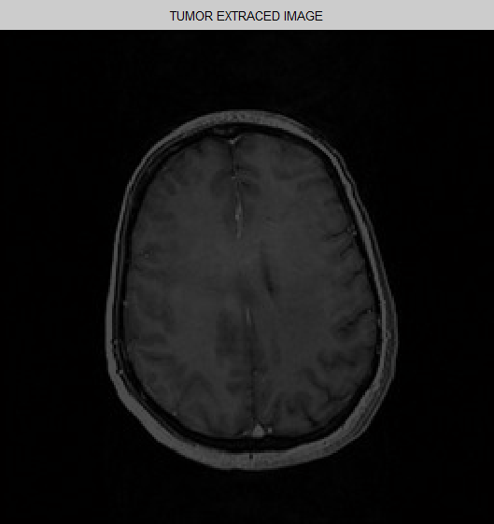
RESULT OF CLASSIFICATION
Abnormal Image
Normal Image

Slide 29
REFERENCES
[1] Herng-Huachang, Ming changchiang, W.H.Sheu, Henry Huang, “A contrast-enhanced trilateral filter for MR image denoising”, IEEE Biomedical Imaging: From Nano to Macro, pp. 1823 – 1826, 2011.
[2] S. Gopinathan P. Thangavel , “A Non Linear Technique for Image Enhancement Based on Discrete Wavelet Transform”, European Journal of Scientific Research , Vol. 79 , pp. 328-33, 2012.
[3] ZeinabA.Mustafa, Banazier A. Abrahim and Yasser M. Kadah, “K11. Modified Hybrid Median Filter for Image Denoising”, National radio science conference, pp. 705 – 712, 2012.
[4] T. SreeSharmila, K. Ramar, “Efficient analysis of hybrid directional lifting technique for satellite image denoising”, Signal, Image and Video Processing, Springer Verlag London Ltd, 2012.
[5] Bagawade Ramdas P, Bhagawat Keshav S, Patil Pradeep M, “Wavelet Transform Techniques for Image Resolution Enhancement: A Study”, International Journal of Emerging Technology and Advanced Engineering, (ISSN 2250-2459), Volume 2, Issue 4, April 2012.

Slide 30
CONTINUE…
[6] Manoj K Kowar and Sourabh Yadav, “Brain Tumor Detction and Segmentation Using Histogram Thresholding”, International Journal of Engineering and Advanced Technology (IJEAT) ISSN: 2249 – 8958, Volume-1, Issue-4, April 2012.
[7] Nitish Zulpe and Vrushsen Pawar, “GLCM Textural Features for Brain Tumor Classification”, IJCSI International Journal of Computer Science Issues, Vol. 9, Issue 3, No 3, May 2012.
[8] Laxmi Ghodke, Apeksha Naik, Rahul Konale, Suchit Mehta, “Brain Cancer Detection using Neuro Fuzzy Logic”, International Journal of Electronic Signals and Systems.
[9] S.Rajeshwari, T.Sree Sharmila, “Efficient Quality Analysis of MRI Image Using Pre-processing Techinques”, IEEE Conference on Information and Communication Technologies, 2013
[10] Pankaj Sapra, Rupinderpal Singh, Shivani Khurana, “Brain Tumor Detection Using Neural Network”, International Journal of Science and Modern Engineering (IJISME), Aug -2013.

Slide 31
THANK YOU

Slide 32
Denoising Techniques
Mean Filter
Replace each pixel by the average of pixels in a square window surrounding this pixel
Trade-off between noise removal and detail preserving:
–Larger window -> can remove noise more effectively, but also blur the details/edges

Slide 33
MEAN FILTER
100 | 100 | 100 | 100 | 100
100 | 200 | 205 | 203 | 100
100 | 195 | 200 | 200 | 100
100 | 200 | 205 | 195 | 100
100 | 100 | 100 | 100 | 100
100 | 100 | 100 | 100 | 100
100 | 200 | 205 | 203 | 100
100 | 195 | 200 | 200 | 100
100 | 200 | 205 | 195 | 100
100 | 100 | 100 | 100 | 100
100+100+100+100+200+205+100+195+200/9 =144
100 | 100 | 100 | 100 | 100
100 | 144 | 167 | 145 | 100
100 | 167 | 200 | 168 | 100
100 | 144 | 166 | 144 | 100
100 | 100 | 100 | 100 | 100
BACK

Slide 34
Continue….
Median Filter
Median filtering is a nonlinear process useful in reducing impulsive, or salt-and-pepper noise.
It is also useful in preserving edges in an image while reducing random noise.
Impulsive or salt-and pepper noise can occur due to a random bit error in a communication channel.
Taking the median value instead of the average or weighted average of pixels in the window

Slide 35
MEDIAN FILTER
100 | 100 | 100 | 100 | 100
100 | 200 | 205 | 203 | 100
100 | 195 | 200 | 200 | 100
100 | 200 | 205 | 195 | 100
100 | 100 | 100 | 100 | 100
100 | 100 | 100 | 100 | 100
100 | 200 | 205 | 203 | 100
100 | 195 | 200 | 200 | 100
100 | 200 | 205 | 195 | 100
100 | 100 | 100 | 100 | 100
100,100,100,100,100,195,200,200,205
100 | 100 | 100 | 100 | 100
100 | 100 | 200 | 100 | 100
100 | 200 | 200 | 200 | 100
100 | 100 | 195 | 100 | 100
100 | 100 | 100 | 100 | 100
BACK

Slide 36
Continue….
Wiener Filter
Wiener Filter is a method of restoring image in the presence of blur as well as noise.
Wiener Filter is to reduce the amount of noise present in an image by comparison with an estimation of the desired noiseless signal.
It remove the additive noise and inverts the blurring simultaneously.
The result obtain by wiener filter is more closer to the original image than Inverse filter.
Back

Slide 37
WIENER FILTER FORMULA
F^(u,v)= 1
|H(u,v)|²
G(u,v)
H(u,v)
|H(u,v)|² + S_{n} (u,v) / S_{f} (u,v)
H(u,v) = degraded function
S_{n}(u,v) = Power Spectra of Noise
S_{f}(u,v) = Power Spectra of undegraded image
G(u,v) = degraded Image

Slide 38
Enhancement Technique
Wavelet Transform
Wavelet transforms have become one of the most important and powerful tools of signal representation. Nowadays, it has been used in image processing, data compression, and signal processing.
Fourier transform can only provide the frequency information. Temporal information is lost in this transformation process.
By using WT both temporal and frequency information can be obtained.
Back

Slide 39
DISCERTE WAVELET TRANSFORM
DWT is a multi resolution decomposition scheme for input signals. The original signals are first decomposed into two subspaces, low-frequency (low- pass) subband and high-frequency (high-pass) subband.

Slide 40
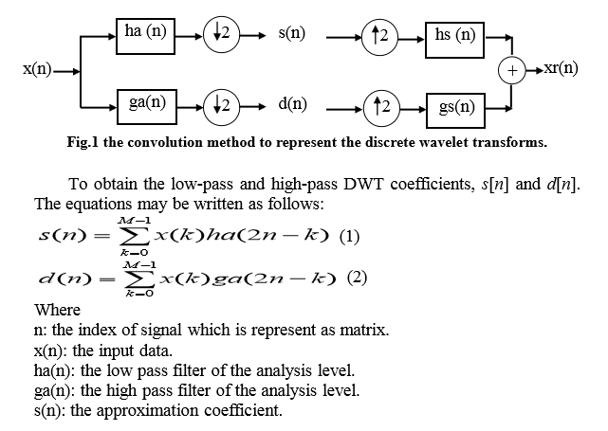
Discrete Wavelet Transform

Slide 41
DISADVANTAGE OF DWT
Lack of shift invariance, which means that small shifts in the input signal can cause major variations in the distribution of energy between DWT coefficients at different scales.
Lack of shift invariance, which means that small shifts in the input signal can cause major variations in the distribution of energy between DWT coefficients at different scales.
BACK

Slide 42
STATIONARY WAVLET TRANSFORM
SWT produces two set of coefficients, approximate coefficient and detail coefficient from the input image.
These vectors are obtained by convolving input image with low-pass filter for approximation and with high-pass filter for detail.
BACK

Slide 43
MSE AND PSNR
Peak Signal to Noise Ratio
PSNR is defined as the ratio between the maximum power of an image to its noise power.
PSNR = 10 log₁₀ (R²/MSE)
R – Maximum Fluctuation in the input image data type
Mean Square Error
MSE is the cumulative squared error between the denoised image and the original image.
MSE = ∑_{M,N} [I_{1(m,n)} - I_{2(m,n)}]^2/ M*N BACK

Slide 44
EXPLANATION
Feature extraction is the process of defining a set of features, or image characteristics, which will most efficiently or meaningfully represent the information that is important for analysis and classification.
GLCM A statistical method of examining texture that considers the spatial relationship of pixels is the gray-level co-occurrence matrix (GLCM), also known as the gray-level spatial dependence matrix. The GLCM functions characterize the texture of an image by calculating how often pairs of pixel with specific values and in a specified spatial relationship occur in an image, creating a GLCM, and then extracting statistical measures from this matrix.

Slide 45
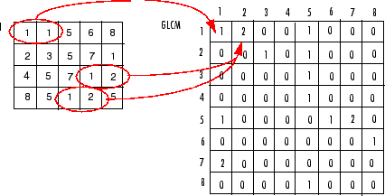
GLCM CALCULATIONS
0 | 0 | 1 | 1
0 | 0 | 1 | 1
0 | 2 | 2 | 2
2 | 2 | 3 | 3
4x4 gray-scale image
0.250 | 0 | 0.083 | 0
0 | 0.167 | 0.083 | 0
0.083 | 0.083 | 0.083 | 0.083
0 | 0 | 0.083 | 0
Co-occurrence matrix
Normalized Co-occurrence matrix

Slide 46
CONTINUED…
Energy = 0.250²+0.000²+0.083²+0.000²+0.000²+0.167²+0.083²+0.000²+0.083²+ 0.083²+0.083²+0.083²+0.000²+0.000²+0.083²+0.000²
= 0.1386
Contrast = (0 − 0)² ∗ 0.250 + (0 − 1)² ∗ 0.000 + (0 − 2)² ∗ 0.083 + (0 − 3)² ∗ 0.000 +(1 − 0)² ∗ 0.000 + (1 − 1)² ∗ 0.167 + (1 − 2)² ∗ 0.083 + (1 − 3)² ∗ 0.000 +(2 − 0)² ∗ 0.083 + (2 − 1⁾² ∗ 0.083 + (2 − 2)² ∗ 0.083 + (2 − 3)² ∗ 0.083 +(3 − 0)² ∗ 0.000 + (3 − 1)² ∗ 0.000 + (3 − 2)² ∗ 0.083 + (3 − 3)² ∗ 0.000 = 0.9960
Entropy = 0.250 ∗ ln(0.250) + 0.000 + 0.083 ∗ ln(0.083) + 0.000 +0.000 + 0.167 ∗ ln(0.167) + 0.083 ∗ ln(0.083) + 0.000 +0.083 ∗ ln(0.083) + 0.083 ∗ ln(0.083) + 0.083 ∗ ln(0.083) + 0.083 ∗ ln(0.083) +0.000 + 0.000 + 0.083 ∗ ln(0.083) + 0.000 = 2.0915
BACK

